Slide 1
Adversarial Robustness in Vision-Based Robot Navigation
Team Hemanth Raj Tekumalla Kodanda Rama Naidu Dumpala

Slide 2
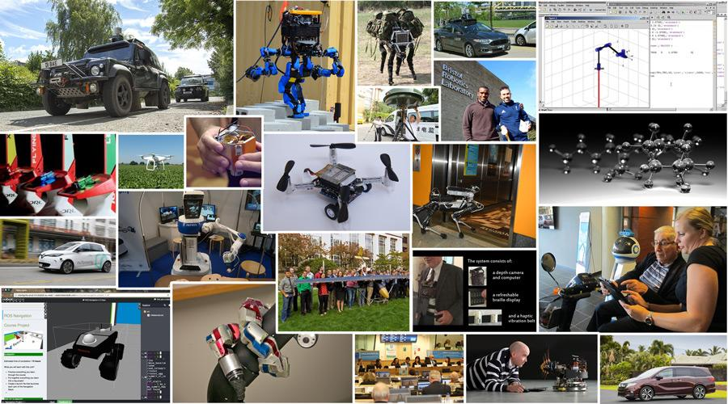
Where Are The Robots?
Vision-based navigation depends on fast, reliable detection of several critical objects.
Small adversarial perturbations can silently suppress detections, creating hidden safety risks.
They're already here. They rely on vision.
What could go wrong?

Slide 3
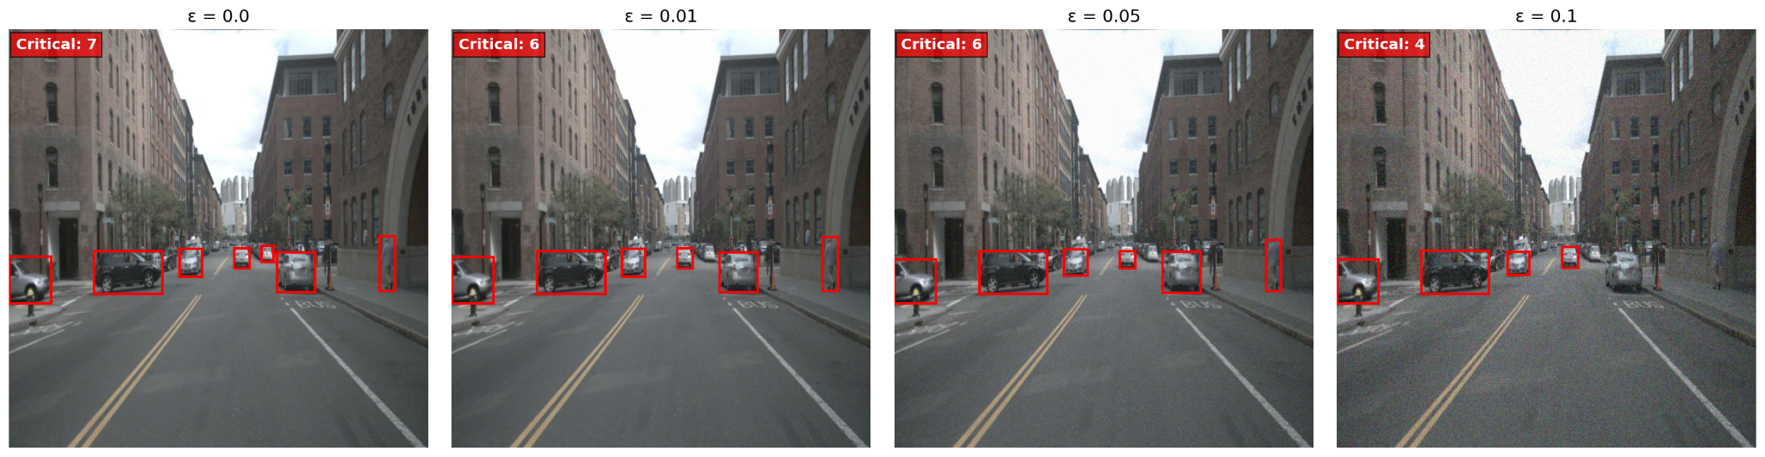
The Silent Threat
What if 1% noise could make a car invisible?

Slide 4
Problem Statement
Measure adversarial perturbations attack impact on critical object detection.
Balance Defenses Trade-offs (recovery vs. latency).
Meet Real-time Constraints.

Slide 5
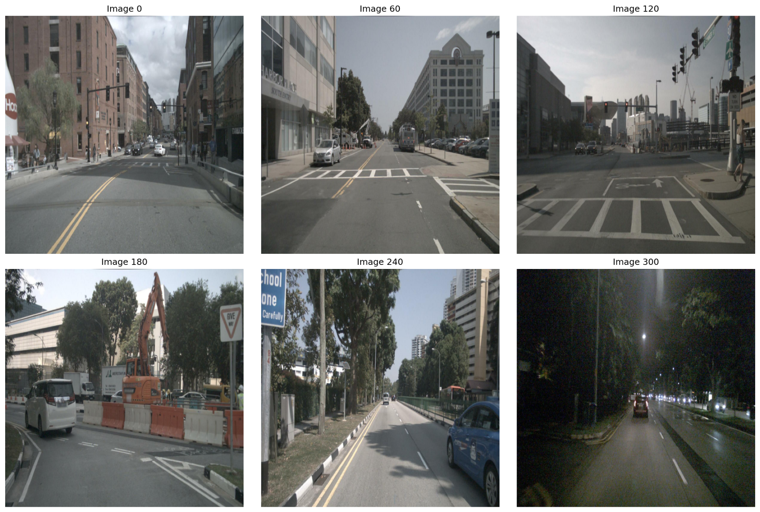
Our Testing Ground - NuScenes Mini Dataset
A total of 400 Front-Camera Images with Urban Driving Scenes in Boston.

Slide 6
The Attack
Targeted Random Perturbations - No hacking required, Just random noise!
3 critical objects vanish with barely visible changes

Slide 7
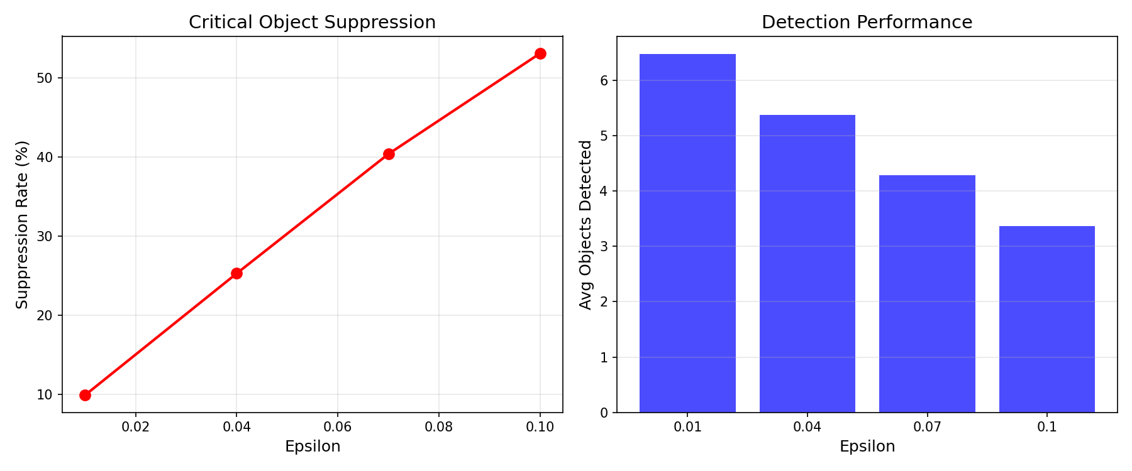
The Numbers Don't Lie
Even tiny perturbations can suppress critical objects
25% failure can be seen at barely visible noise

Slide 8
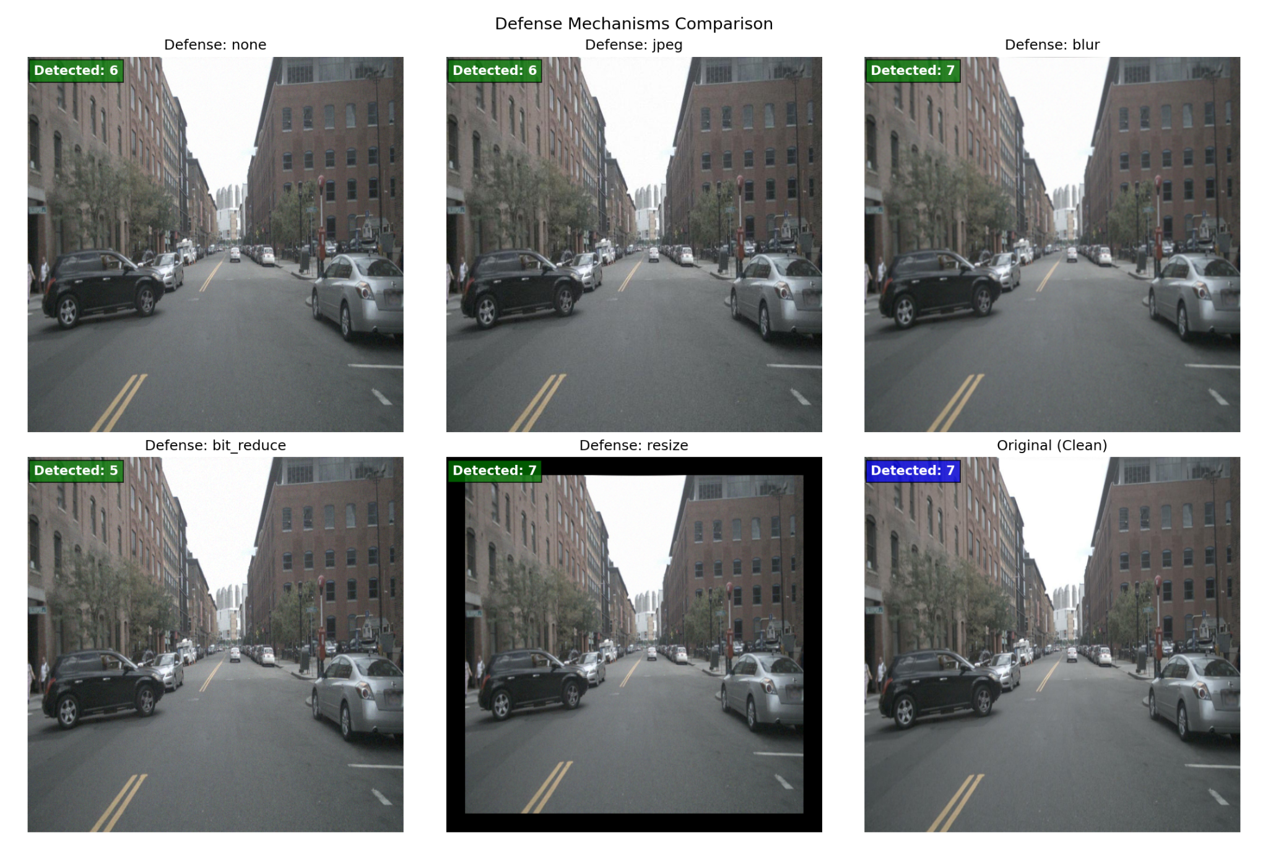
Fighting Back
Can simple preprocessing save the day?

Slide 9
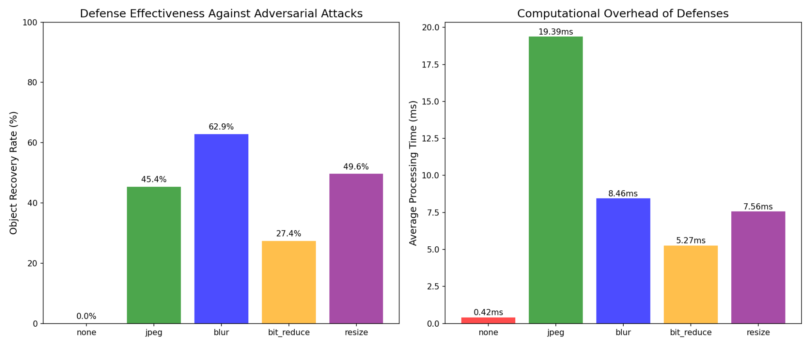
The Winner
Gaussian Blur: 62.9% recovery
8.46ms - Fast enough for real-time

Slide 10
Key Takeaways
Adversarial perturbations suppress critical detections by about 28.3% at ε=0.01, 47.6% at ε=0.03, and 63.8% at ε=0.05, corresponding to roughly 1.2, 2.1, and 2.8 objects lost per image.
Gaussian blur recovers 62.9% with 8.46 ms overhead (<10 ms).
Resize-pad 49.6% (7.56 ms); Bit-depth 27.4% (5.27 ms); JPEG 45.4% (19.39 ms).
Even after defenses, about 45% of suppression remains at ε≈0.03–0.05, indicating the need for sensor redundancy and online anomaly monitoring.

Slide 11
Future Work
Test on physical perturbations
Evaluate ensemble of defenses
Integrate with sensor fusion approaches

Slide 12
Any Questions?

